Slide 1
Marina Rates 2023
Port of KINGSTON Commission
August 24, 2022

Slide 2
Agenda
State of the boating industry
  Trends in boating and marina occupancy
  Future outlook
Rate setting strategies
Findings

Slide 3
Trends & Future Prospects

Slide 4
New Boat Sales Washington State (Over 26 feet)
Source: NMTA/Sea Grant DOL database
517 boats/year
399 boats/year
144 boats/year
Sales down 2.9%
in Q1-Q2 2022 vs 2021
for >26 ft boats

Slide 5
Washington State Boats (26+ft)
Per 1,000 Residents Sources: DOL, OFM
Fleet size stable at +/- 25,000 boats 26+ ft
Boats per 1,000 persons,
down from 4.0 in 2000
to 3.2 in 2020

Slide 6
Boating/Marina Findings
Demand
  Fleet size has remained stable
  Boating sales “boom” occurred during Covid
  Downturn in sales is possible
    Aging boaters,
    Growth in boat sharing/clubs,
    Ability to retain new boaters.
Supply
  Moorage supply has not grown
    No new marinas being developed
    Steady or declining supply as older, marginal marinas close
  Sale of marinas to private equity or REIT companies

Slide 7
Rate Setting Strategies

Slide 8
Marina Rates
Base on competitive marina rates
  Average or percentile of Puget Sound marinas
Increase at CPI or other index
Set to cover costs and ROI
  Demand and capital expenditures
  Market comparison and ROI

Slide 9
2022 Rate Increases
Marina | Open | Covered
Kingston | 10%-14% | 10%-11%
Shilshole Bay | 5.0%
Elliott Bay | 9%-15%+
Everett C/S | 3%-19% | 7%-19%
Edmonds | 6.5% | 6.5%
Cap Sante | 3%-7%
Anacortes | 8%-10% | 10%
Kingston 2022 rate increases were slightly higher than most competitors, but playing catch up for low historic rates.

Slide 10
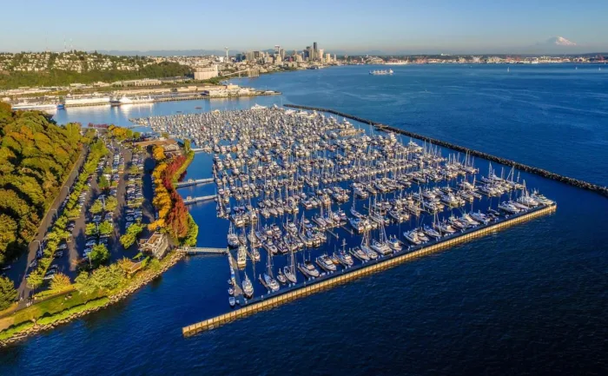
Elliott Bay Marina Sells for $80.5 million Source: Trade Only
Southern Marinas Holdings II acquired Elliott Bay Marina in July 2021 for $80.5 million
Rates in 2022
  Eliminated loyalty rate
  Rates increased 9% to 15%
Elliott Bay Marina is one of the largest facilities on the West Coast, with more than 1,200 slips for vessels to 300 feet, hundreds of moorings, repair facilities, two restaurants, a Freedom Boat Club and more.

Slide 11
Moorage Rate Comparisons
40 foot slips
Open
Covered
Kingston: 46% lower in 2015, 25% lower in 2022
Kingston: 42% lower in 2015, 32% lower in 2022

Slide 12
Marina Rates - Findings
Needs
  Fund capital repair and replacement of the marina.
  Fund other capital requirements (seawall, breakwater, dredging, replace and upgrade bathrooms; and other dock improvements).
  Operating expenses go up as the docks get older.
Costs are increasing
  In-water work, permitting takes longer and costs more, environmental mitigation.
Demand is strong
  Wait lists demonstrate that there is mo.re demand than supply.
  Occupancy is high.
Financial capacity is limited.
Therefore, net operating income from the marina must increase for the marina to be sustainable.
Increase rates...

Slide 13
Marina Rates – Kingston
Based on competitive marina rates
  Kingston has had very low rates historically,
  Playing catch up now
CPI or other index
  CPI +1% has been low for most marinas until now
Set rates to cover costs and required ROI
  Demand and capital expenditures
  Kingston has a cash flow model that tracks financial capability to meet capital needs

